Slide 1

Website Development: Lesson 4
Facilitated by: Titus Kariuki
Notes:
Web development kahoot

Slide 2
What I’ll need from you today
What I’ll need from you today
Seriousness…lots of it.
No talking without permission
No playing around
No banging of laptops
No earphones or headphones
No Spotify or playing music in the background
You came to learn how to code, not to play around.

Slide 3
Agenda
1. Ice breaker
2. Recap
3. Id Attribute
4. Lesson 2 Challenge 2: Seasonal ids
5. Introduction to maps
6. Lesson 2 challenge 3 - Maps.html

Slide 4
Ice Breaker
Career interests
What’s something you think you’d like to do 10 or 20 years from now?
Favorite extracurricular activity
What’s something you like to do in school that’s not class-related? (Acapella, art, dancing, etc.)
DO NOT SAY VIDEO GAMES!!!

Slide 5
Recap
What html tag is used to add images?
What is the “alt” element?
Why is CSS important?

Slide 6
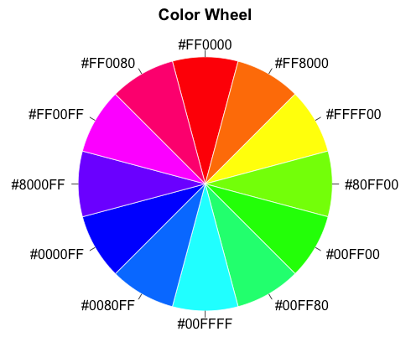
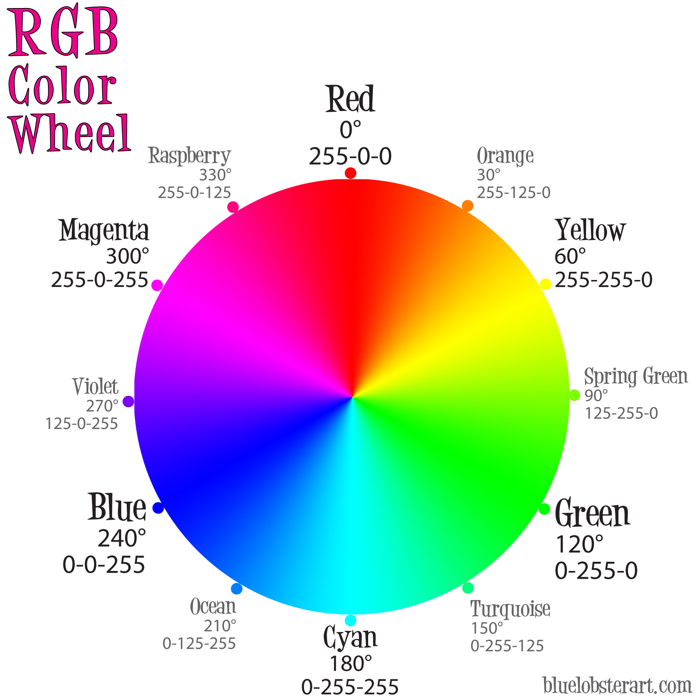
Recap - Colors
Computers don’t speak English
They talk in numbers
We use hex or RGB numbers.
An example of hex
#ee82ee
An example of RBG
rgb(250, 25, 123)

Slide 7

ID Attribute
What do you see?
A basket of fruit
What fruits does the basket have?
Bananas
Apples
Grapes
Peaches
Pineapple
Strawberries
Citrus
Kiwi
Passion fruit

Slide 8
ID Attribute
ID = basket
Fruit = styles
The ID is a basket of styles

Slide 9
ID Attribute
Bold
Italics
Underlined
Links
Vestibulum congue
ID
Font Color
Font Style
Spacing
Background color
Type of font
Font size
Elements
ID

Slide 10
Practice
Practice - Create an ID

Slide 11
iFrame tags
iFrame tags
<iframe>

Slide 12
IFrame tags
An iFrame tag is used to put a website inside a website.
Code:
<iframe src="url" title="description"></iframe>
You can make it as large or as small as you want.

Slide 13
Practice
Practice - Create an iframe

Slide 14
Introduction to Maps
How to embed google maps
Iframe tag
Used to embed another document in a current html document
We are NOT coding google maps from scratch, just linking what is already on the internet
Need to have the iframe in a paragraph so there is space allocated to the display

Slide 15
Lesson 2 Challenge 3 - Maps.html
How to use iframe tag
Embed the link of any other webpage between the opening and closing tags
Similar to embedding images, must use “scr” after the tag to specify the address of the embedded document/link
Resource: https://www.w3schools.com/tags/tag_iframe.ASP

Slide 16
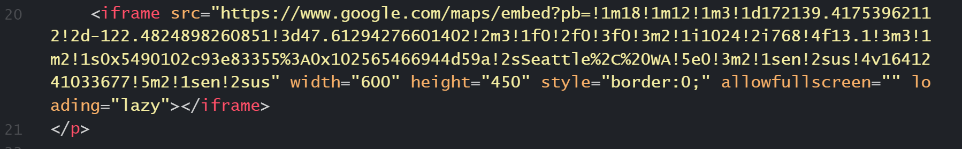
Lesson 2 Challenge 3 - Maps.html
How to use iframe tag
Set the look of the embed link by adjusting the height and width
Set the border to the bounds you would like
Specify if you would like to allow the embedded document to take up a full screen

Slide 17
Lesson 2 Challenge 3 - Maps.html
Challenge checklist
Declare html webpage
Title for maps
CSS design for title
Paragraph to embed image

Slide 18
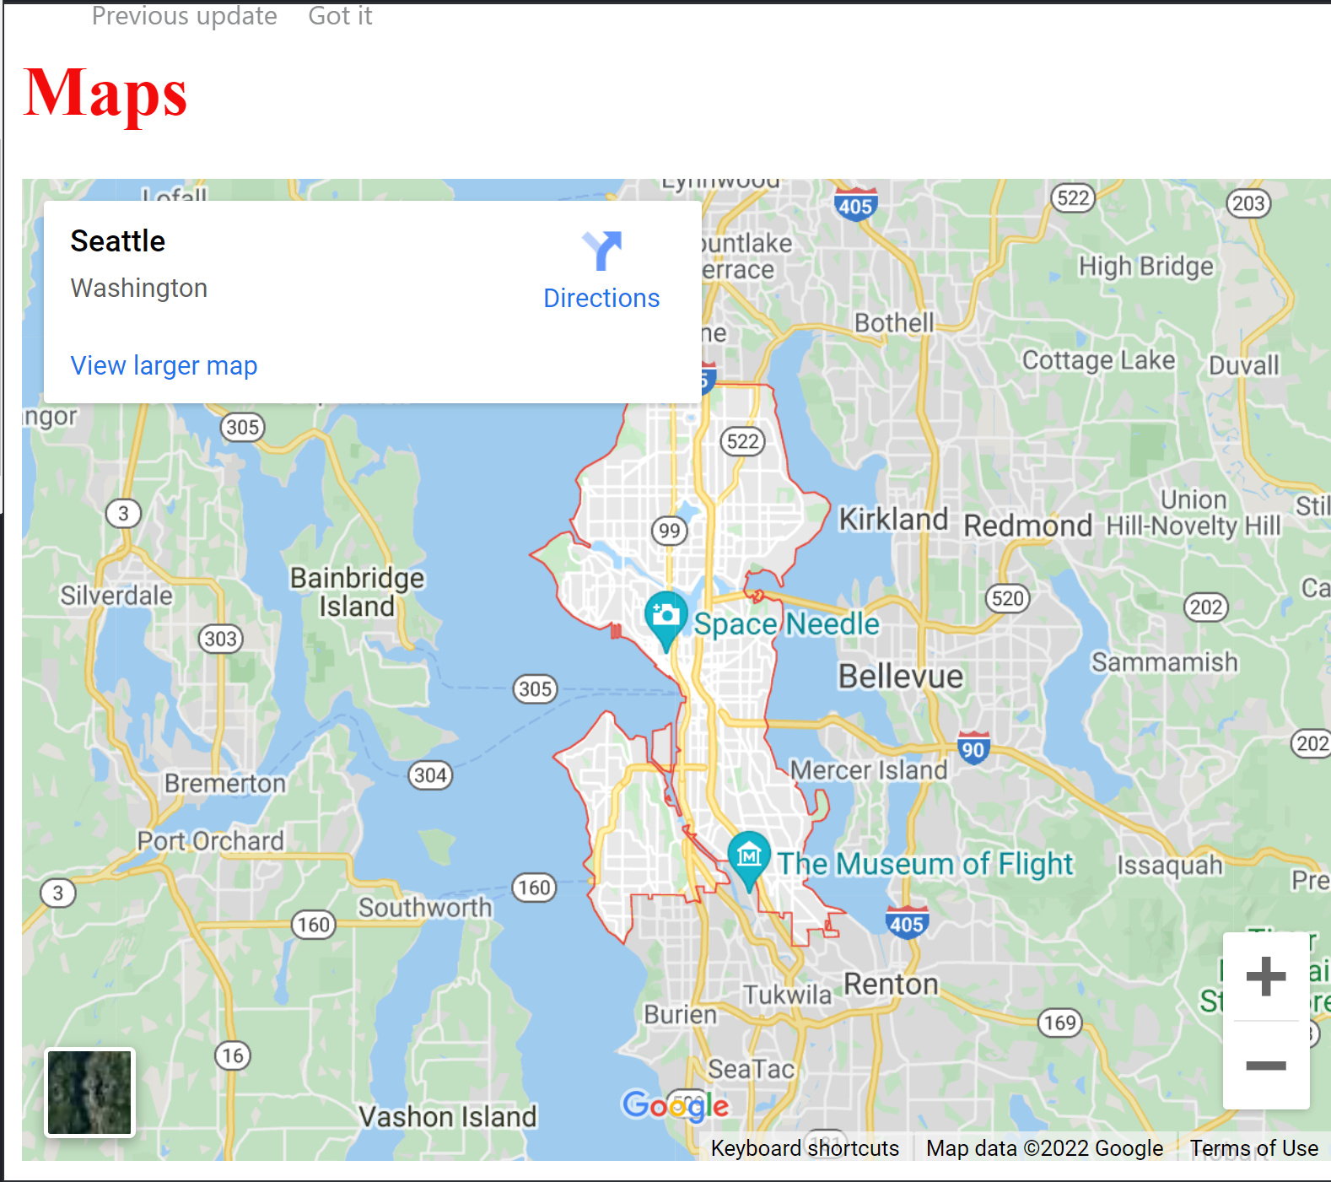
Lesson 2 Challenge 3 - Maps.html
Iframe tag
Ex: <iframe scr = “insert link here” width = “#” height = “#” style = border:0;” allowfullscreen= “” loading = “lazy”></iframe>

Slide 19

Questions?

